Slide 1
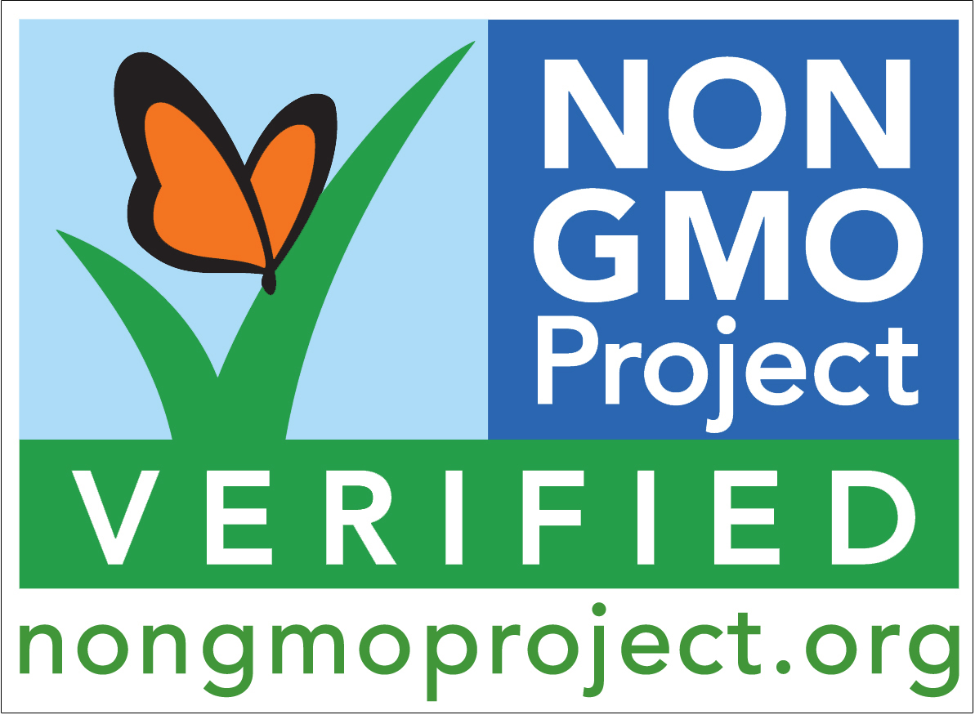
Project Non-GMO
Mike McCormick – Project Lead
Neil Carrico – Backend Database
James Scott – Backend Database
Bridger Lewis – Backend/ UI/UX

Slide 2
Background
GMOs (genetically modified organisms) are living organisms whose genetic material has been artificially manipulated in a laboratory through genetic engineering.
Only private organizations currently verify Non-GMOs.
Packaging and labeling can be confusing or inaccurate.
Notes:
Organic means you just don’t use pesticides or spray that harm the product. USDA regulates the testing and labeling of Organic. All Natural, No artificial ingredients.

Slide 3
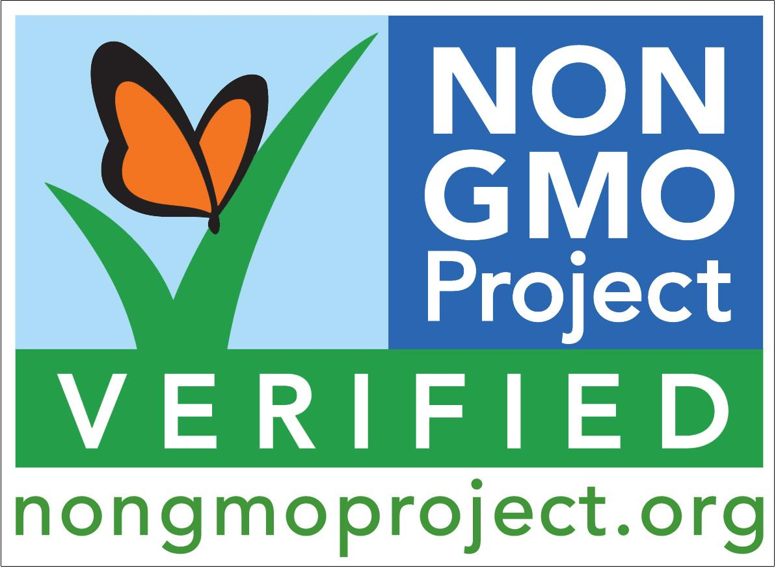
Our Vision
Produce an app that enables the average consumer to make an immediate, educated decision.
Keep the app quick, clean, and simple.
Provide easy to understand information on the products’ Non-GMO status and competing prices.
Low tech user interface.
Notes:
Produce a good shopping experience.
Give the user the most enjoyable experience.
Allows consumers with low technical skill to be able to use.

Slide 4


Categories
Manual Input
Scan
Google Vision API
Database
Non-GMO
GMO
Notes:
Why we chose Android. Why we chose MySQL and Vision API

Slide 5
Our Struggles
Getting ProjectNon-GMO.org to cooperate with our Senior Design Project.
Actually implementing ProjectNon-GMO.org database into our application.
Balancing other class work with the end goal which is creating an application to easily scan the barcodes of foods and get instant reply of if product is Non-GMO.

Slide 7
Notes:
You can even see on the M&M package that this product has been partially produced with genetic engineering.

Slide 8
Future goals of our app
Improve the User Interface
More in depth price comparison
Optimize the searching algorithm
Include knowledge of:
Organic
Ingredients ( aspartame, high fructose corn syrup, trans fat, etc.)
Allergens/Intolerances
Diet restrictions (Vegetarian, Vegan , Paleo, etc.)

